Slide 1
ICS 2303 Multinedia Systems
Lecture 6:Data Compression

Slide 2
Data and is information?
Can we measure information?
Consider the two following sentences:
There is a traffic jam on I5
There is a traffic jam on I5 near Exit 234
Sentence 2 seems to have more information than that of sentence 1. From the semantic viewpoint, sentence 2 provides more useful information.

Slide 3
What is information?
It is hard to measure the “semantic” information!
Consider the following two sentences
There is a traffic jam on I5 near Exit 160
There is a traffic jam on I5 near Exit 234
It’s not clear whether sentence 1 or 2 would have more information!

Slide 4
What is information?
Let’s attempt at a different definition of information.
  How about counting the number of letters in the two sentences:
There is a traffic jam on I5 (22 letters)
There is a traffic jam on I5 near Exit 234 (33 letters)

Slide 5






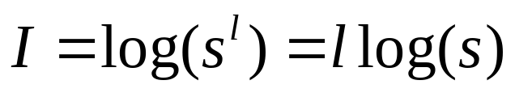



What is information?
It’s interesting to know that log is the only function that satisfies
First attempt to quantify information by Hartley (1928).
  Every symbol of the message has a choice of possibilities.
  A message of length , therefore can have distinguishable possibilities.
  Information measure is then the logarithm of
Intuitively, this definition makes sense:
one symbol (letter) has the information of then a sentence of length
should have times more information, i.e.

Slide 6
How about we measure information as the number of Yes/No questions one has to ask to get the correct answer to a simple game below
1 | 2
3 | 4
How many questions?
2
1 | 2 | 3 | 4
5 | 6 |  | 8
9 | 10 | 11 | 12
13 | 14 | 15 | 16
How many questions?
7
4
Randomness due to uncerntainty of where the circle is!

Slide 7
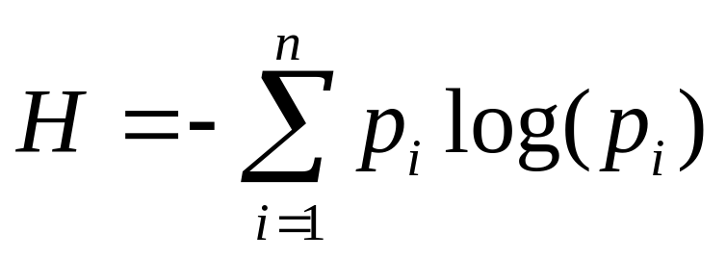


Shannon’s Information Theory
Claude Shannon: A Mathematical Theory of Communication
Bell System Technical Journal, 1948
Shannon’s measure of information is the number of bits to represent the amount of uncertainty (randomness) in a data source, and is defined as entropy
Where there are symbols 1, 2, … , each with
probability of occurrence of

Slide 8
Shannon’s Entropy
Consider the following string consisting of symbols a and b:
  abaabaababbbaabbabab… ….
  On average, there are equal number of a and b.
  The string can be considered as an output of a below source with equal probability of outputting symbol a or b:
0.5
a
We want to characterize the average information generated by the source!
0.5
b
source

Slide 9





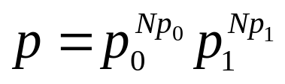
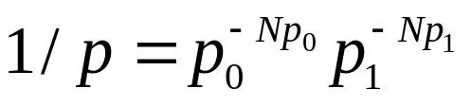
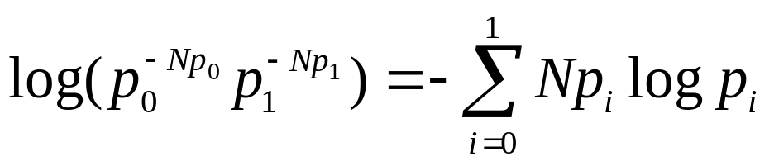
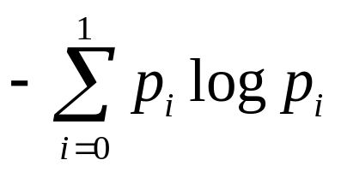
Intuition on Shannon’s Entropy
Why
Suppose you have a long random string of two binary symbols 0 and 1, and the probability of symbols 1 and 0 are and
Ex: 00100100101101001100001000100110001 ….
If any string is long enough say , it is likely to contain 0’s and 1’s. The probability of this string pattern occurs is equal to
Hence, # of possible patterns is
# bits to represent all possible patterns is
The average # of bits to represent the symbol is therefore

Slide 10
More Intuition on Entropy
Assume a binary memoryless source, e.g., a flip of a coin. How much information do we receive when we are told that the outcome is heads?
  If it’s a fair coin, i.e., P(heads) = P (tails) = 0.5, we say that the amount of information is 1 bit.
  If we already know that it will be (or was) heads, i.e., P(heads) = 1, the amount of information is zero!
  If the coin is not fair, e.g., P(heads) = 0.9, the amount of information is more than zero but less than one bit!
  Intuitively, the amount of information received is the same if P(heads) = 0.9 or P (heads) = 0.1.

Slide 11
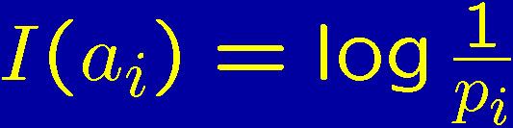
Self Information
So, let’s look at it the way Shannon did.
Assume a memoryless source with
  alphabet A = (a₁, …, a_{n})
  symbol probabilities (p₁, …, p_{n}).
How much information do we get when finding out that the next symbol is a_{i}?
According to Shannon the self information of a_{i} is

Slide 12


Why?
Assume two independent events A and B, with
probabilities P(A) = p_{A} and P(B) = p_{B}.
For both the events to happen, the probability is
p_{A} ¢ p_{B}. However, the amount of information
should be added, not multiplied.
Logarithms satisfy this!
No, we want the information to increase with
decreasing probabilities, so let’s use the negative
logarithm.

Slide 13
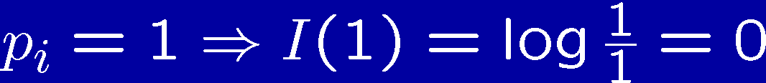
Self Information
Example 1:
Example 2:
Which logarithm? Pick the one you like! If you pick the natural log,
you’ll measure in nats, if you pick the 10-log, you’ll get Hartleys,
if you pick the 2-log (like everyone else), you’ll get bits.

Slide 14




Self Information
On average over all the symbols, we get:
H(X) is called the first order entropy of the source.
This can be regarded as the degree of uncertainty
about the following symbol.

Slide 15
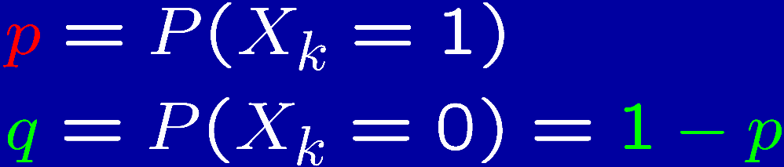
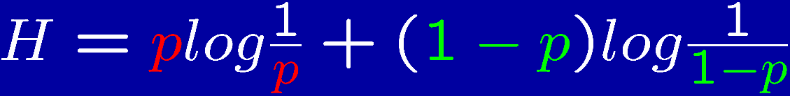

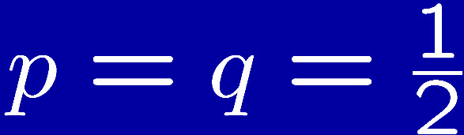
Entropy
Example: Binary Memoryless Source
BMS
0 1 1 0 1 0 0 0 …
Let
Then
Often denoted
1
The uncertainty (information) is greatest when
0
0.5
1

Slide 16
Example
Three symbols a, b, c with corresponding probabilities:
P = {0.5, 0.25, 0.25}
What is H(P)?
Three weather conditions in Corvallis: Rain, sunny, cloudy with corresponding probabilities:
Q = {0.48, 0.32, 0.20}
What is H(Q)?

Slide 17
Entropy: Three properties
It can be shown that 0 · H · log N.
Maximum entropy (H = log N) is reached when all symbols are equiprobable, i.e.,
p_{i} = 1/N.
The difference log N – H is called the redundancy of the source.

Slide 18
Encoding and Compression of Data
Fax Machines
ASCII
Variations on ASCII
  min number of bits needed
  cost of savings
  patterns
  modifications
CS 102

Slide 19
Definition: Compression means storing data in a format that requires less space than usual.
Data compression is particularly useful in communications because it enables devices to transmit the same amount of data in fewer bits.

Slide 20
The bandwidth of a digital communication link can be effectively increased by compressing data at the sending end and decompressing data at the receiving end.
There are a variety of data compression techniques, but only a few have been standardized.

Slide 21
Types of Data Compression
There are two main types of data compression : Lossy and Lossless.
In Lossy data compression the message can never be recovered exactly as it was before it was compressed.

Slide 22
In a Lossless data compression file the original message can be exactly decoded.
Lossless compression is ideal for text.
Huffman coding is type of lossless data compression.

Slide 23
Compression Algorithms
Huffman Coding
Run Length Encoding
Arithmetic Codes
Lempel ziv 77 and Variants

Slide 24
Huffman Coding
Huffman coding is a popular compression technique that assigns variable length codes (VLC) to symbols, so that the most frequently occurring symbols have the shortest codes.
On decompression the symbols are reassigned their original fixed length codes.

Slide 25
The idea is to use short bit strings to represent the most frequently used characters
and to use longer bit strings to represent less frequently used characters.

Slide 26
That is, the most common characters, usually space, e, and t are assigned the shortest codes.
In this way the total number of bits required to transmit the data can be considerably less than the number required if the fixed length ASCII representation is used.
A Huffman code is a binary tree with branches assigned the value 0 or 1.

Slide 27
Huffman Coding
Proposed by Dr. David A. Huffman in 1952
  “A Method for the Construction of Minimum Redundancy Codes”
Applicable to many forms of data transmission
  Our example: text files
CS 102
Notes:
An Introduction to Huffman Coding
March 21, 2000
Mike Scott

Slide 28
The Basic Algorithm
Huffman coding is a form of statistical coding
Not all characters occur with the same frequency!
Yet all characters are allocated the same amount of space
  1 char = 1 byte, be it e or x
CS 102
Notes:
An Introduction to Huffman Coding
March 21, 2000
Mike Scott

Slide 29
The Basic Algorithm
Any savings in tailoring codes to frequency of character?
Code word lengths are no longer fixed like ASCII.
Code word lengths vary and will be shorter for the more frequently used characters.
CS 102
Notes:
An Introduction to Huffman Coding
March 21, 2000
Mike Scott

Slide 30
The (Real) Basic Algorithm
1. Scan text to be compressed and tally occurrence of all characters.
2. Sort or prioritize characters based on number of occurrences in text.
3. Build Huffman code tree based on prioritized list.
4. Perform a traversal of tree to determine all code words.
5. Scan text again and create new file using the Huffman codes.
CS 102
Notes:
An Introduction to Huffman Coding
March 21, 2000
Mike Scott

Slide 31
Building a Tree
Scan the original text
Consider the following short text:
Eerie eyes seen near lake.
Count up the occurrences of all characters in the text
CS 102
Notes:
An Introduction to Huffman Coding
March 21, 2000
Mike Scott

Slide 32
Building a Tree
Scan the original text
Eerie eyes seen near lake.
What characters are present?
E e r i space
y s n a r l k .
CS 102
Notes:
An Introduction to Huffman Coding
March 21, 2000
Mike Scott

Slide 33
Building a Tree
Scan the original text
Eerie eyes seen near lake.
What is the frequency of each character in the text?
Char Freq. Char Freq. Char Freq.
E 1 y 1 k 1
e 8 s 2 . 1
r 2 n 2
i 1 a 2
space 4 l 1
CS 102
Notes:
An Introduction to Huffman Coding
March 21, 2000
Mike Scott

Slide 34
Building a Tree
Prioritize characters
Create binary tree nodes with character and frequency of each character
Place nodes in a priority queue
  The lower the occurrence, the higher the priority in the queue
CS 102
Notes:
An Introduction to Huffman Coding
March 21, 2000
Mike Scott

Slide 35
Building a Tree
Prioritize characters
Uses binary tree nodes
public class HuffNode
{
public char myChar;
public int myFrequency;
public HuffNode myLeft, myRight;
}
priorityQueue myQueue;
CS 102
Notes:
An Introduction to Huffman Coding
March 21, 2000
Mike Scott

Slide 36
Building a Tree
The queue after inserting all nodes
Null Pointers are not shown
E
1
i
1
y
1
l
1
k
1
.
1
r
2
s
2
n
2
a
2
sp
4
e
8
CS 102
Notes:
An Introduction to Huffman Coding
March 21, 2000
Mike Scott

Slide 37
Building a Tree
While priority queue contains two or more nodes
  Create new node
  Dequeue node and make it left subtree
  Dequeue next node and make it right subtree
  Frequency of new node equals sum of frequency of left and right children
  Enqueue new node back into queue
CS 102
Notes:
An Introduction to Huffman Coding
March 21, 2000
Mike Scott

Slide 38
Building a Tree
E
1
i
1
y
1
l
1
k
1
.
1
r
2
s
2
n
2
a
2
sp
4
e
8
CS 102
Notes:
An Introduction to Huffman Coding
March 21, 2000
Mike Scott

Slide 39
Building a Tree
y
1
l
1
k
1
.
1
r
2
s
2
n
2
a
2
sp
4
e
8
2
E
1
i
1
CS 102
Notes:
An Introduction to Huffman Coding
March 21, 2000
Mike Scott

Slide 40
Building a Tree
y
1
l
1
k
1
.
1
r
2
s
2
n
2
a
2
2
sp
4
e
8
E
1
i
1
CS 102
Notes:
An Introduction to Huffman Coding
March 21, 2000
Mike Scott

Slide 41
Building a Tree
k
1
.
1
r
2
s
2
n
2
a
2
2
sp
4
e
8
E
1
i
1
2
y
1
l
1
CS 102
Notes:
An Introduction to Huffman Coding
March 21, 2000
Mike Scott

Slide 42
Building a Tree
k
1
.
1
r
2
s
2
n
2
a
2
2
2
sp
4
e
8
y
1
l
1
E
1
i
1
CS 102
Notes:
An Introduction to Huffman Coding
March 21, 2000
Mike Scott

Slide 43
Building a Tree
r
2
s
2
n
2
a
2
2
2
sp
4
e
8
y
1
l
1
E
1
i
1
2
k
1
.
1
CS 102
Notes:
An Introduction to Huffman Coding
March 21, 2000
Mike Scott

Slide 44
Building a Tree
r
2
s
2
n
2
a
2
2
2
sp
4
e
8
2
E
1
i
1
y
1
l
1
k
1
.
1
CS 102
Notes:
An Introduction to Huffman Coding
March 21, 2000
Mike Scott

Slide 45
Building a Tree
n
2
a
2
2
sp
4
e
8
2
2
E
1
i
1
y
1
l
1
k
1
.
1
4
r
2
s
2
CS 102
Notes:
An Introduction to Huffman Coding
March 21, 2000
Mike Scott

Slide 46
Building a Tree
n
2
a
2
2
sp
4
e
8
2
2
4
E
1
i
1
y
1
l
1
k
1
.
1
r
2
s
2
CS 102
Notes:
An Introduction to Huffman Coding
March 21, 2000
Mike Scott

Slide 47
Building a Tree
2
4
e
8
2
2
sp
4
y
1
l
1
k
1
.
1
r
2
s
2
E
1
i
1
4
n
2
a
2
CS 102
Notes:
An Introduction to Huffman Coding
March 21, 2000
Mike Scott

Slide 48
Building a Tree
2
4
4
e
8
2
2
sp
4
y
1
l
1
k
1
.
1
r
2
s
2
n
2
a
2
E
1
i
1
CS 102
Notes:
An Introduction to Huffman Coding
March 21, 2000
Mike Scott

Slide 49
Building a Tree
4
4
e
8
2
sp
4
k
1
.
1
r
2
s
2
n
2
a
2
4
2
2
E
1
i
1
y
1
l
1
CS 102
Notes:
An Introduction to Huffman Coding
March 21, 2000
Mike Scott

Slide 50
Building a Tree
2
4
4
4
sp
4
e
8
2
2
k
1
.
1
r
2
s
2
n
2
a
2
E
1
i
1
y
1
l
1
CS 102
Notes:
An Introduction to Huffman Coding
March 21, 2000
Mike Scott

Slide 51
Building a Tree
4
4
4
e
8
2
2
r
2
s
2
n
2
a
2
E
1
i
1
y
1
l
1
6
2
sp
4
k
1
.
1
CS 102
Notes:
An Introduction to Huffman Coding
March 21, 2000
Mike Scott

Slide 52
Building a Tree
4
4
4
6
e
8
2
sp
4
r
2
s
2
n
2
a
2
2
2
k
1
.
1
E
1
i
1
y
1
l
1
What is happening to the characters with a low number of occurrences?
CS 102
Notes:
An Introduction to Huffman Coding
March 21, 2000
Mike Scott

Slide 53
Building a Tree
4
6
e
8
2
2
2
sp
4
E
1
i
1
y
1
l
1
k
1
.
1
8
4
4
r
2
s
2
n
2
a
2
CS 102
Notes:
An Introduction to Huffman Coding
March 21, 2000
Mike Scott

Slide 54
Building a Tree
4
6
e
8
8
2
2
2
sp
4
4
4
E
1
i
1
y
1
l
1
k
1
.
1
r
2
s
2
n
2
a
2
CS 102
Notes:
An Introduction to Huffman Coding
March 21, 2000
Mike Scott

Slide 55
Building a Tree
e
8
8
4
4
10
r
2
s
2
n
2
a
2
4
6
2
2
2
sp
4
E
1
i
1
y
1
l
1
k
1
.
1
CS 102
Notes:
An Introduction to Huffman Coding
March 21, 2000
Mike Scott

Slide 56
Building a Tree
e
8
8
10
4
4
4
6
n
2
a
2
2
2
2
r
2
s
2
sp
4
E
1
i
1
y
1
l
1
k
1
.
1
CS 102
Notes:
An Introduction to Huffman Coding
March 21, 2000
Mike Scott

Slide 57
Building a Tree
10
16
4
6
2
2
2
e
8
8
sp
4
E
1
i
1
y
1
l
1
k
1
.
1
4
4
r
2
s
2
n
2
a
2
CS 102
Notes:
An Introduction to Huffman Coding
March 21, 2000
Mike Scott

Slide 58
Building a Tree
10
16
4
6
e
8
8
2
2
2
sp
4
4
4
E
1
i
1
y
1
l
1
k
1
.
1
r
2
s
2
n
2
a
2
CS 102
Notes:
An Introduction to Huffman Coding
March 21, 2000
Mike Scott

Slide 59
Building a Tree
26
16
10
4
e
8
8
6
2
2
2
sp
4
4
4
E
1
i
1
y
1
l
1
k
1
.
1
r
2
s
2
n
2
a
2
CS 102
Notes:
An Introduction to Huffman Coding
March 21, 2000
Mike Scott

Slide 60
Building a Tree
After enqueueing this node there is only one node left in priority queue.
26
16
10
4
e
8
8
6
2
2
2
sp
4
4
4
E
1
i
1
y
1
l
1
k
1
.
1
r
2
s
2
n
2
a
2
CS 102
Notes:
An Introduction to Huffman Coding
March 21, 2000
Mike Scott

Slide 61
Building a Tree
Dequeue the single node left in the queue.
This tree contains the new code words for each character.
Frequency of root node should equal number of characters in text.
26
16
10
4
e
8
8
6
2
2
2
4
sp
4
4
E
1
i
1
y
1
l
1
k
1
.
1
r
2
s
2
n
2
a
2
Eerie eyes seen near lake.  26 characters
CS 102
Notes:
An Introduction to Huffman Coding
March 21, 2000
Mike Scott

Slide 62
Encoding the File
Traverse Tree for Codes
Perform a traversal of the tree to obtain new code words
Going left is a 0 going right is a 1
code word is only completed when a leaf node is reached
26
16
10
4
e
8
8
6
2
2
2
4
sp
4
4
E
1
i
1
y
1
l
1
k
1
.
1
r
2
s
2
n
2
a
2
CS 102
Notes:
An Introduction to Huffman Coding
March 21, 2000
Mike Scott

Slide 63
Encoding the File
Traverse Tree for Codes
Char Code
E 0000
i 0001
y 0010
l 0011
k 0100
. 0101
space 011
e 10
r 1100
s 1101
n 1110
a 1111
26
16
10
4
e
8
8
6
2
2
2
4
sp
4
4
E
1
i
1
y
1
l
1
k
1
.
1
r
2
s
2
n
2
a
2
CS 102
Notes:
An Introduction to Huffman Coding
March 21, 2000
Mike Scott

Slide 64
Encoding the File
Rescan text and encode file using new code words
Eerie eyes seen near lake.
Char Code
E 0000
i 0001
y 0010
l 0011
k 0100
. 0101
space 011
e 10
r 1100
s 1101
n 1110
a 1111
0000101100000110011100010101101101001111101011111100011001111110100100101
Why is there no need for a separator character?
.
CS 102
Notes:
An Introduction to Huffman Coding
March 21, 2000
Mike Scott

Slide 65
Encoding the File
Results
Have we made things any better?
73 bits to encode the text
ASCII would take 8 * 26 = 208 bits
0000101100000110011100010101101101001111101011111100011001111110100100101
If modified code used 4 bits per
character are needed. Total bits
4 * 26 = 104. Savings not as great.
CS 102
Notes:
An Introduction to Huffman Coding
March 21, 2000
Mike Scott

Slide 66
Decoding the File
How does receiver know what the codes are?
Tree constructed for each text file.
  Considers frequency for each file
  Big hit on compression, especially for smaller files
Tree predetermined
  based on statistical analysis of text files or file types
Data transmission is bit based versus byte based
CS 102
Notes:
An Introduction to Huffman Coding
March 21, 2000
Mike Scott

Slide 67
Decoding the File
Once receiver has tree it scans incoming bit stream
0 ⇒ go left
1 ⇒ go right
26
16
10
4
e
8
8
6
2
2
2
4
sp
4
4
10100011011110111101111110000110101
E
1
i
1
y
1
l
1
k
1
.
1
r
2
s
2
n
2
a
2
CS 102

Slide 68
Summary
Huffman coding is a technique used to compress files for transmission
Uses statistical coding
  more frequently used symbols have shorter code words
Works well for text and fax transmissions
An application that uses several data structures
CS 102

